Slide 1
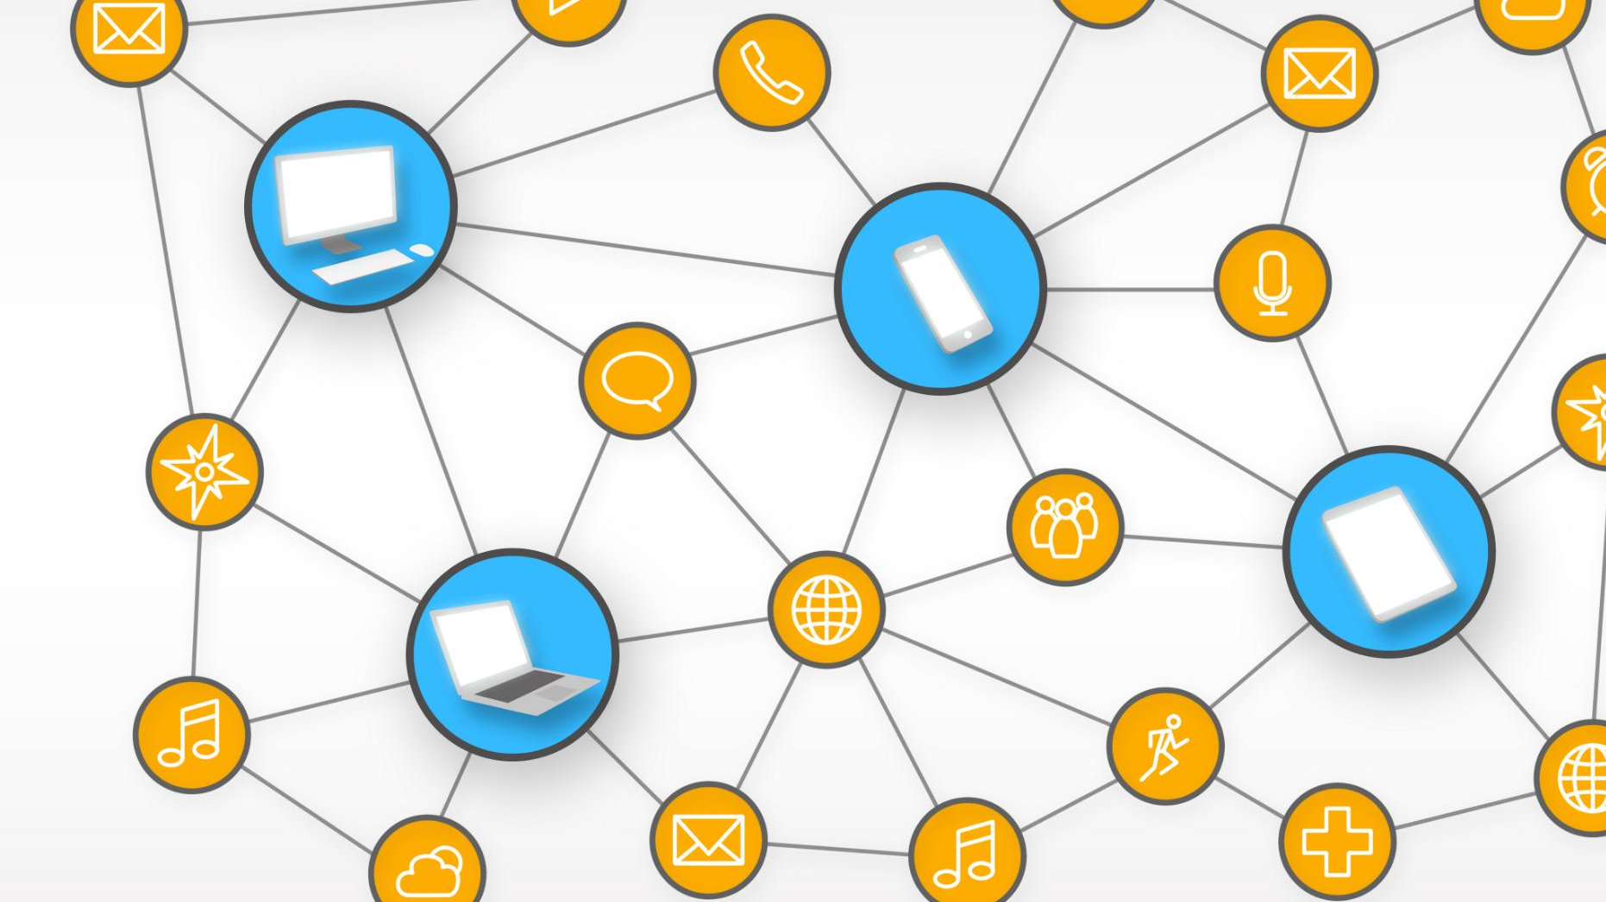
Understanding Tokenization and Embedding in Natural Language Processing
Key concepts and techniques in NLP explained
Notes:
AI-generated content may be incorrect. --- This presentation will provide an in-depth understanding of tokenization and embedding in NLP. We will explore basic concepts, techniques like Byte Pair Encoding, the fundamentals of embedding, and the role of embedding layers in large language models. Finally, we will discuss practical applications and future directions in this field.

Slide 2
Presentation Topics
Basic Concepts of Tokenization
Byte Pair Encoding (BPE) in Tokenization
Fundamentals of Embedding in NLP
Large Language Models (LLM) Embedding Layer
Applications and Future Directions
Notes:
In this presentation, we will cover the basic concepts of tokenization, including its definition, types, and challenges. We will look at Byte Pair Encoding as a tokenization method, discuss the fundamentals of embedding in NLP, and explore the embedding layer in large language models. Lastly, we will examine practical applications and future trends in NLP.

Slide 3
Basic Concepts of Tokenization
Notes:
Tokenization is a fundamental step in NLP that involves breaking text into smaller units, or tokens. Understanding this process is crucial for transforming raw text into a format suitable for analysis and modeling.

Slide 4

Definition and Importance of Tokenization
What is Tokenization?
Tokenization involves breaking down text into smaller units like words or phrases, making it easier to analyze.
Role in NLP
Tokenization is crucial in Natural Language Processing as it allows machines to interpret and manipulate text data effectively.
Facilitating Analysis
By tokenizing text, we enable further analysis, such as sentiment analysis, topic modeling, and machine learning tasks.
Notes:
Tokenization is the process of dividing text into meaningful components, such as words or phrases. It is important because it helps machines understand and process text data, enabling further analysis and applications in NLP.

Slide 5
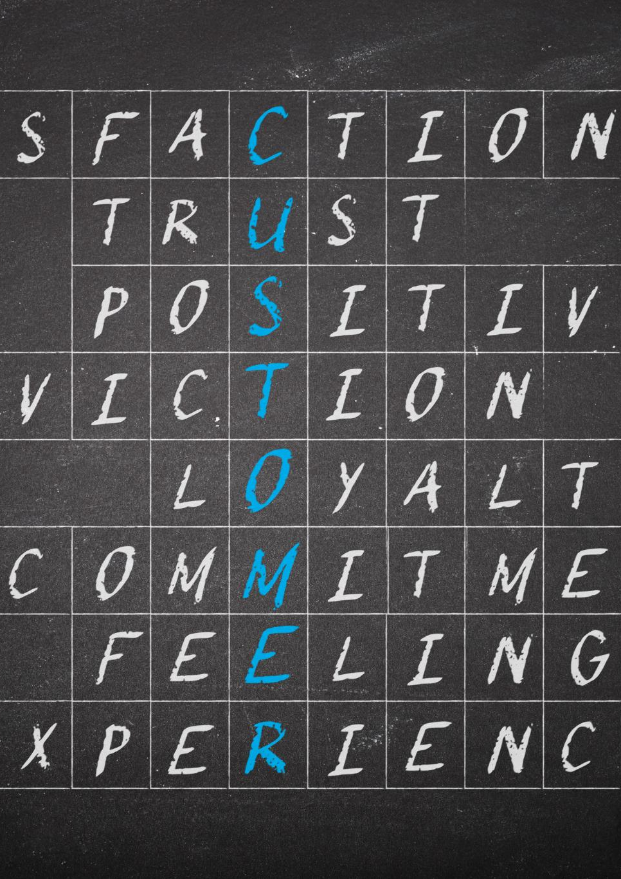
Types of Tokenization: Word, Character, and Subword
Word Tokenization
Word tokenization divides text into distinct words, making it useful for tasks like text classification and sentiment analysis.
Character Tokenization
Character tokenization splits text into individual characters, allowing for fine-grained analysis and handling of rare words.
Subword Tokenization
Subword tokenization breaks down words into smaller meaningful units, enabling better handling of vocabulary and out-of-vocabulary words.
Notes:
Tokenization can be categorized into different types: word tokenization, which divides text into words; character tokenization, which splits text into individual characters; and subword tokenization, which breaks down words into smaller meaningful units. Each type has its advantages and is used in various NLP tasks.

Slide 6
Challenges in Tokenization
Handling Punctuation
One challenge in tokenization is managing punctuation effectively to ensure accurate text processing.
Contextual Meanings
Distinguishing between different meanings of words in context is crucial for accurate tokenization.
Languages Without Spaces
Tokenization is more complex in languages that do not use spaces, requiring innovative approaches.
Notes:
Tokenization presents several challenges, including handling punctuation, distinguishing between different meanings in context, and dealing with languages that do not use spaces. Addressing these challenges is crucial for effective text processing.

Slide 7
Byte Pair Encoding (BPE) in Tokenization
Notes:
Byte Pair Encoding (BPE) is a popular subword tokenization technique that helps address the limitations of traditional tokenization methods. It merges the most frequent pairs of characters or subwords, allowing for a more efficient representation of text.

Slide 8

Introduction to BPE
Algorithmic Tokenization
BPE utilizes an algorithmic method to tokenize text by replacing frequent byte pairs, enhancing text processing efficiency.
Handling OOV Words
One of the key advantages of BPE is its ability to effectively manage out-of-vocabulary (OOV) words in language processing.
Vocabulary Size Reduction
BPE significantly reduces the vocabulary size, resulting in more efficient models and lesser memory consumption.
Notes:
BPE is an algorithmic approach to tokenization that iteratively replaces the most frequent pairs of bytes or characters with a single, unused byte or character. This method helps in handling out-of-vocabulary words and reducing the vocabulary size.

Slide 9

How BPE Works: Merging Frequent Pairs
Initial Character List
The BPE algorithm begins by listing all individual characters present in the source text, establishing a foundational set for processing.
Merging Common Pairs
The algorithm identifies and merges the most frequently occurring character pairs to form new tokens, enhancing efficiency.
Vocabulary Size Limitation
Merging continues until a specific vocabulary size is achieved, balancing the need for comprehensive representation with processing efficiency.
Notes:
The BPE algorithm starts with a list of all characters in the text and iteratively merges the most common pairs into new tokens. This process continues until a predefined vocabulary size is reached, effectively balancing the need for comprehensiveness and efficiency.

Slide 10
Advantages and Use Cases of BPE
Reduced Vocabulary Size
BPE reduces the vocabulary size, making it easier to manage and process large datasets in NLP applications.
Handling of Rare Words
BPE provides better handling of rare words, improving the overall performance of language models.
Applications in NLP
BPE is widely used in modern NLP applications, enhancing text representation in models like transformers and neural networks.
Notes:
BPE has several advantages, including reduced vocabulary size and better handling of rare words. It is widely used in modern NLP applications, particularly in language models that require efficient and accurate text representation.

Slide 11
Fundamentals of Embedding in NLP
Notes:
Embeddings are a crucial part of NLP that allows words or phrases to be represented as vectors in a continuous vector space. This representation helps capture semantic relationships and contextual information.

Slide 12

What Is Embedding?
Definition of Embedding
Embedding in NLP is the process of converting discrete tokens into continuous vector representations, facilitating better machine understanding.
Semantic Understanding
This mapping enables algorithms to discern semantic meanings, which enhances their performance in various tasks.
Applications in NLP
Embeddings are crucial for improving machine learning tasks such as translation, sentiment analysis, and more.
Notes:
In NLP, embedding refers to the mapping of discrete tokens (like words) to continuous vector spaces. This process allows algorithms to understand semantic meanings, enabling machines to perform better in tasks like translation, sentiment analysis, and more.

Slide 13

Importance of Embedding in NLP
Understanding Linguistic Features
Embeddings help models understand linguistic features by converting words into numerical representations.
Improving Model Performance
By using embeddings, models can improve their performance across various NLP tasks, enhancing their overall effectiveness.
Context Understanding
Embeddings facilitate better understanding of context, allowing models to make more accurate predictions based on word relationships.
Notes:
Embeddings are essential in NLP because they enable models to grasp linguistic features and relationships between words. They improve performance on various tasks, allowing for better context understanding and generalization.

Slide 14

Common Embedding Techniques
Word2Vec
Word2Vec is a popular technique that uses neural networks to create word vectors based on context within text.
GloVe
GloVe (Global Vectors for Word Representation) captures global statistical information of words to create meaningful embeddings.
FastText
FastText enhances Word2Vec by considering subword information, which helps in understanding rare words and morphological variations.
Notes:
Some common embedding techniques include Word2Vec, GloVe, and FastText. These methods differ in how they create word vectors and capture semantic similarities, each with its own strengths and applications.

Slide 15
Large Language Models (LLM) Embedding Layer
Notes:
Large language models incorporate embeddings to process and generate text efficiently. The embedding layer is critical for transforming input text into numerical representations that the model can understand.

Slide 16
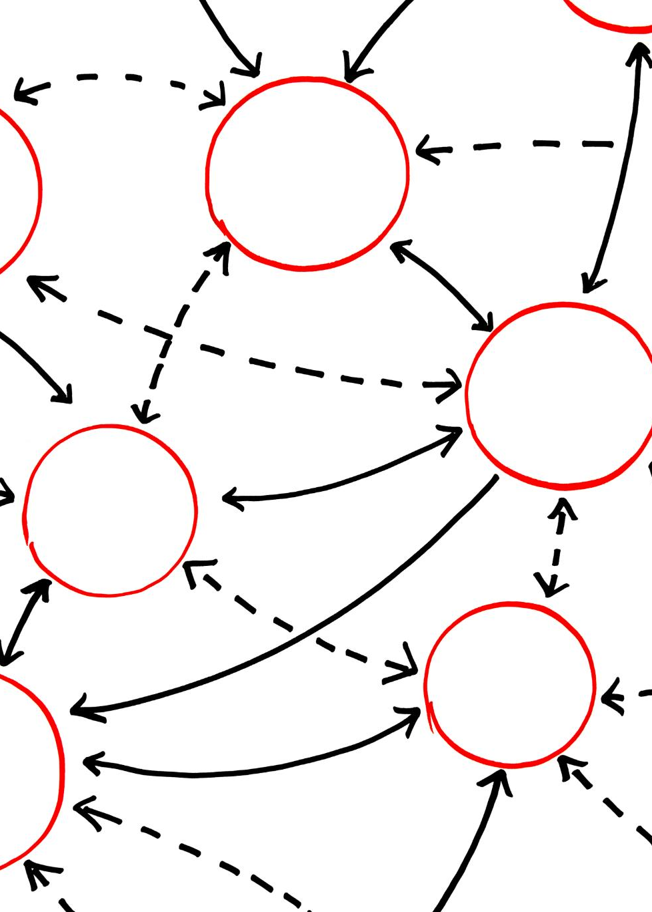
Overview of Large Language Models
Understanding Human-like Text
Large language models are designed to comprehend and generate text that resembles human language, enhancing communication with machines.
Advanced Architectures
These models utilize sophisticated architectures that allow for better understanding of context and semantics in language processing.
Role of Embedding Layer
The embedding layer is crucial for converting words into numerical forms that can be processed by the model, foundational for language understanding.
Notes:
Large language models, such as GPT and BERT, leverage vast amounts of data and sophisticated architectures to understand and generate human-like text. The embedding layer is a foundational component of these models.

Slide 17

Role of the Embedding Layer in LLMs
Text to Vector Transformation
The embedding layer transforms input text into dense vectors, representing words in a numerical format.
Capturing Relationships
The embedding layer captures intricate relationships between words and phrases, enhancing the model's understanding of context.
Notes:
The embedding layer in large language models serves to convert input text into dense vectors. This transformation allows the models to process text more effectively and capture intricate relationships between words and phrases.

Slide 18
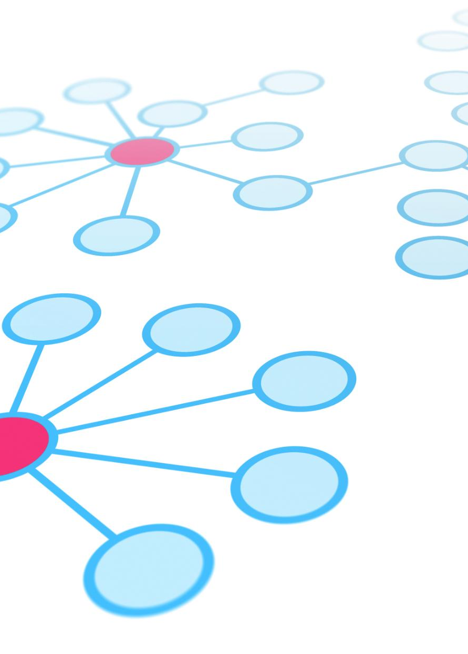
How Embeddings Are Generated in LLMs
Learned Representations
Embeddings in LLMs start as learned representations derived from vast amounts of training data.
Error Minimization
During training, embeddings are fine-tuned to minimize the error in predictions, enhancing their effectiveness.
Contextual Representations
Final embeddings result in effective contextual representations for understanding and generating coherent text.
Notes:
In large language models, embeddings are generated using learned representations from training data. These embeddings are adjusted during training to minimize error, resulting in effective contextual representations for understanding and generating text.

Slide 19
Applications and Future Directions
Notes:
Tokenization and embedding are foundational concepts in NLP, with numerous applications in various domains. As technology advances, there are exciting opportunities for further improvements and innovative applications.

Slide 20

Practical Applications of Tokenization and Embedding
Sentiment Analysis
Tokenization and embedding techniques are vital for accurately analyzing sentiments in text data, enhancing understanding of user emotions.
Machine Translation
These techniques improve machine translation systems, enabling more accurate and fluent translations across different languages.
Chatbot Development
Tokenization and embedding enhance chatbot interactions, allowing for more natural conversations and better understanding of user queries.
Information Retrieval
These methods enable efficient information retrieval from large datasets, ensuring users find relevant data quickly and accurately.
Notes:
Tokenization and embedding techniques are applied in diverse areas, including sentiment analysis, machine translation, chatbot development, and information retrieval. Their effectiveness is evident in many modern NLP applications.

Slide 21
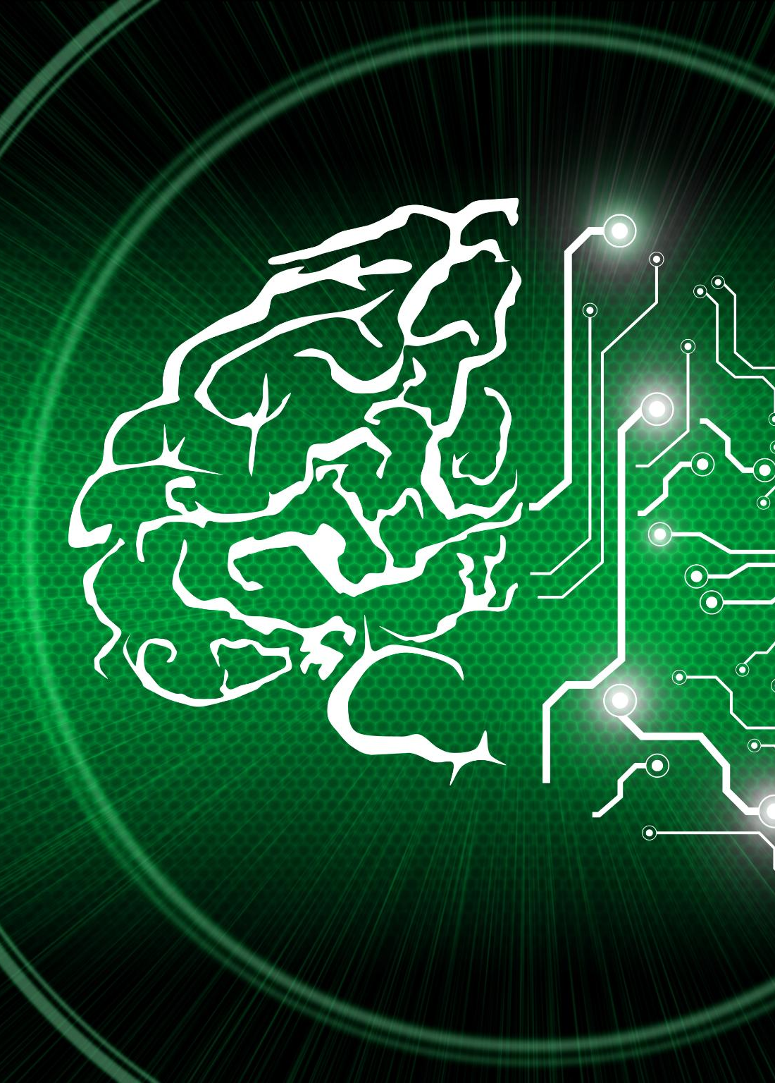
Current Advancements in NLP
Deep Learning Models
Recent advancements in deep learning models have greatly improved the performance of NLP tasks, enabling better understanding of language.
Tokenization Techniques
Improved tokenization techniques are essential for breaking down text into manageable parts, enhancing the processing of language data.
Enhanced Embedding Methods
New embedding methods provide richer representations of words, leading to better context understanding in NLP applications.
Notes:
Recent advancements in NLP include the development of deep learning models, improved tokenization techniques, and enhanced embedding methods. These innovations are driving significant progress in the field.

Slide 22

Future Trends and Potential Improvements
Tokenization Techniques
Advancements in tokenization techniques will improve the processing of multilingual texts and enhance overall performance.
Embedding Improvements
Future models will feature more efficient embedding methods, allowing for better representation of language semantics.
Interpretability in NLP
Enhanced interpretability will allow users to understand model decisions, fostering trust in NLP applications.
Notes:
Looking ahead, we can expect continued improvements in tokenization and embedding techniques, including better handling of multilingual texts, more efficient models, and enhanced interpretability. The future of NLP holds great promise.

Slide 23
Conclusion
Importance of Tokenization
Tokenization is a crucial step in natural language processing, breaking text into manageable pieces for analysis.
Role of Embeddings
Embeddings provide a way to represent words in a continuous vector space, enabling meaningful comparisons and computations.
Future of NLP
As technology evolves, tokenization and embedding techniques will continue to advance, impacting NLP applications and development.
Notes:
In conclusion, understanding tokenization and embedding is essential for anyone looking to work in natural language processing. These concepts form the backbone of numerous applications and will continue to evolve, shaping the future of NLP.

